Slide 1
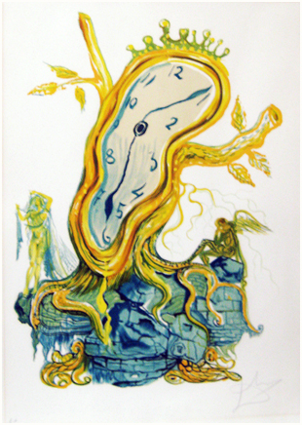
UH Systematics fall 2019:
Molecular clocks
Camiel Doorenweerd
20191001

Slide 2
1965 Zuckerkandl & Pauling
“Molecules as documents of Evolutionary history”
Substitutions accumulate as a function of time

Slide 3
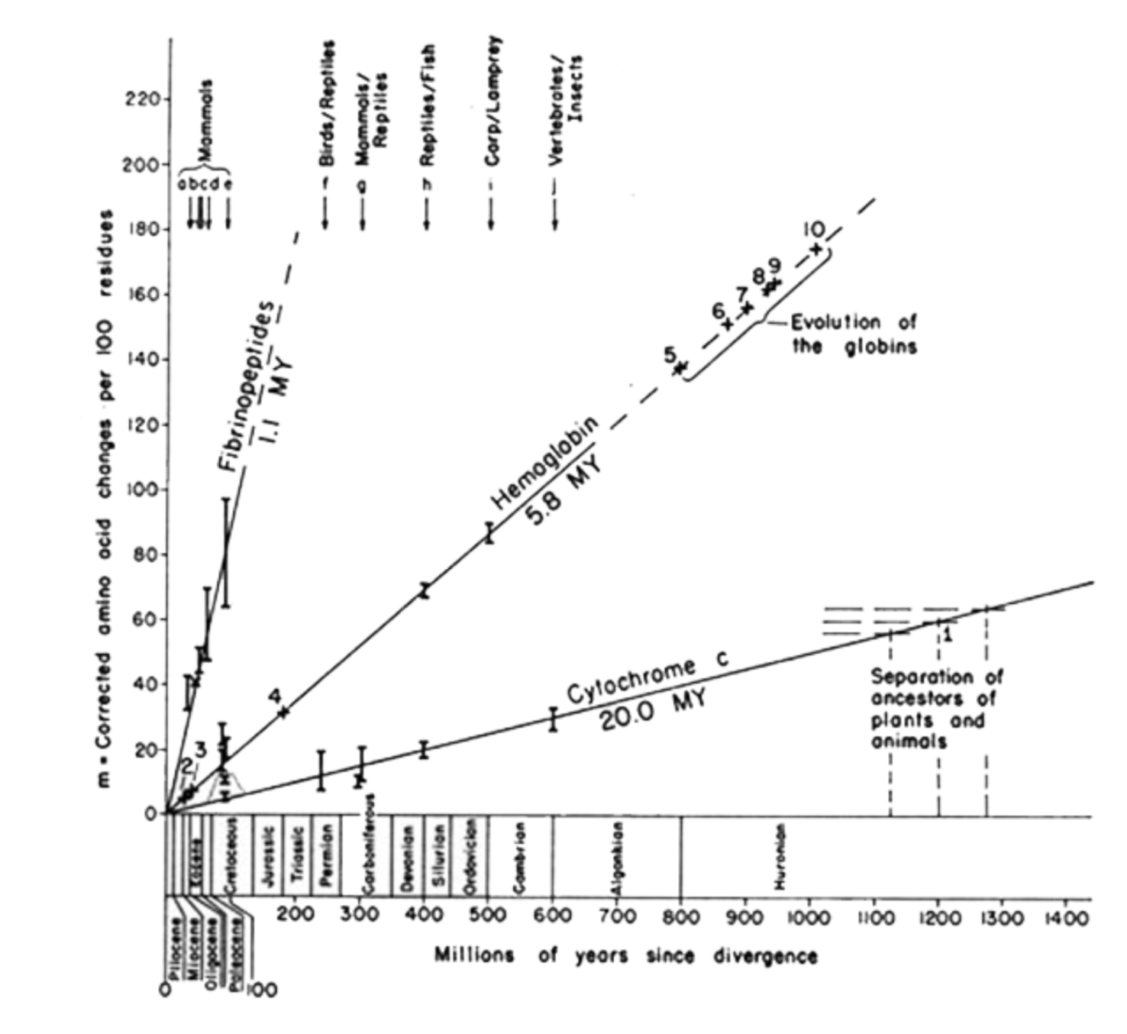
Dickerson 1971: a linear representation

Slide 4
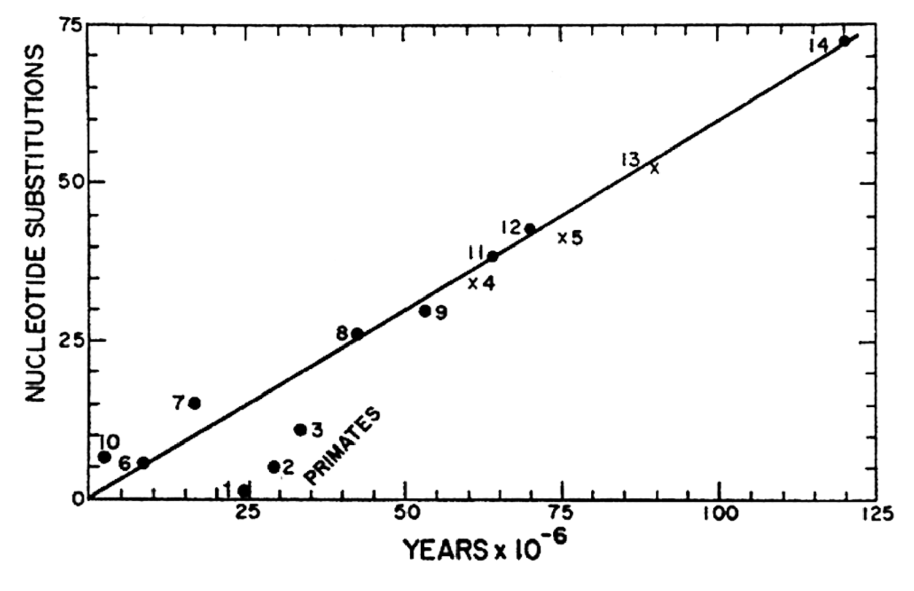
Langley and Fitch 1974
“Primate slowdown”

Slide 5
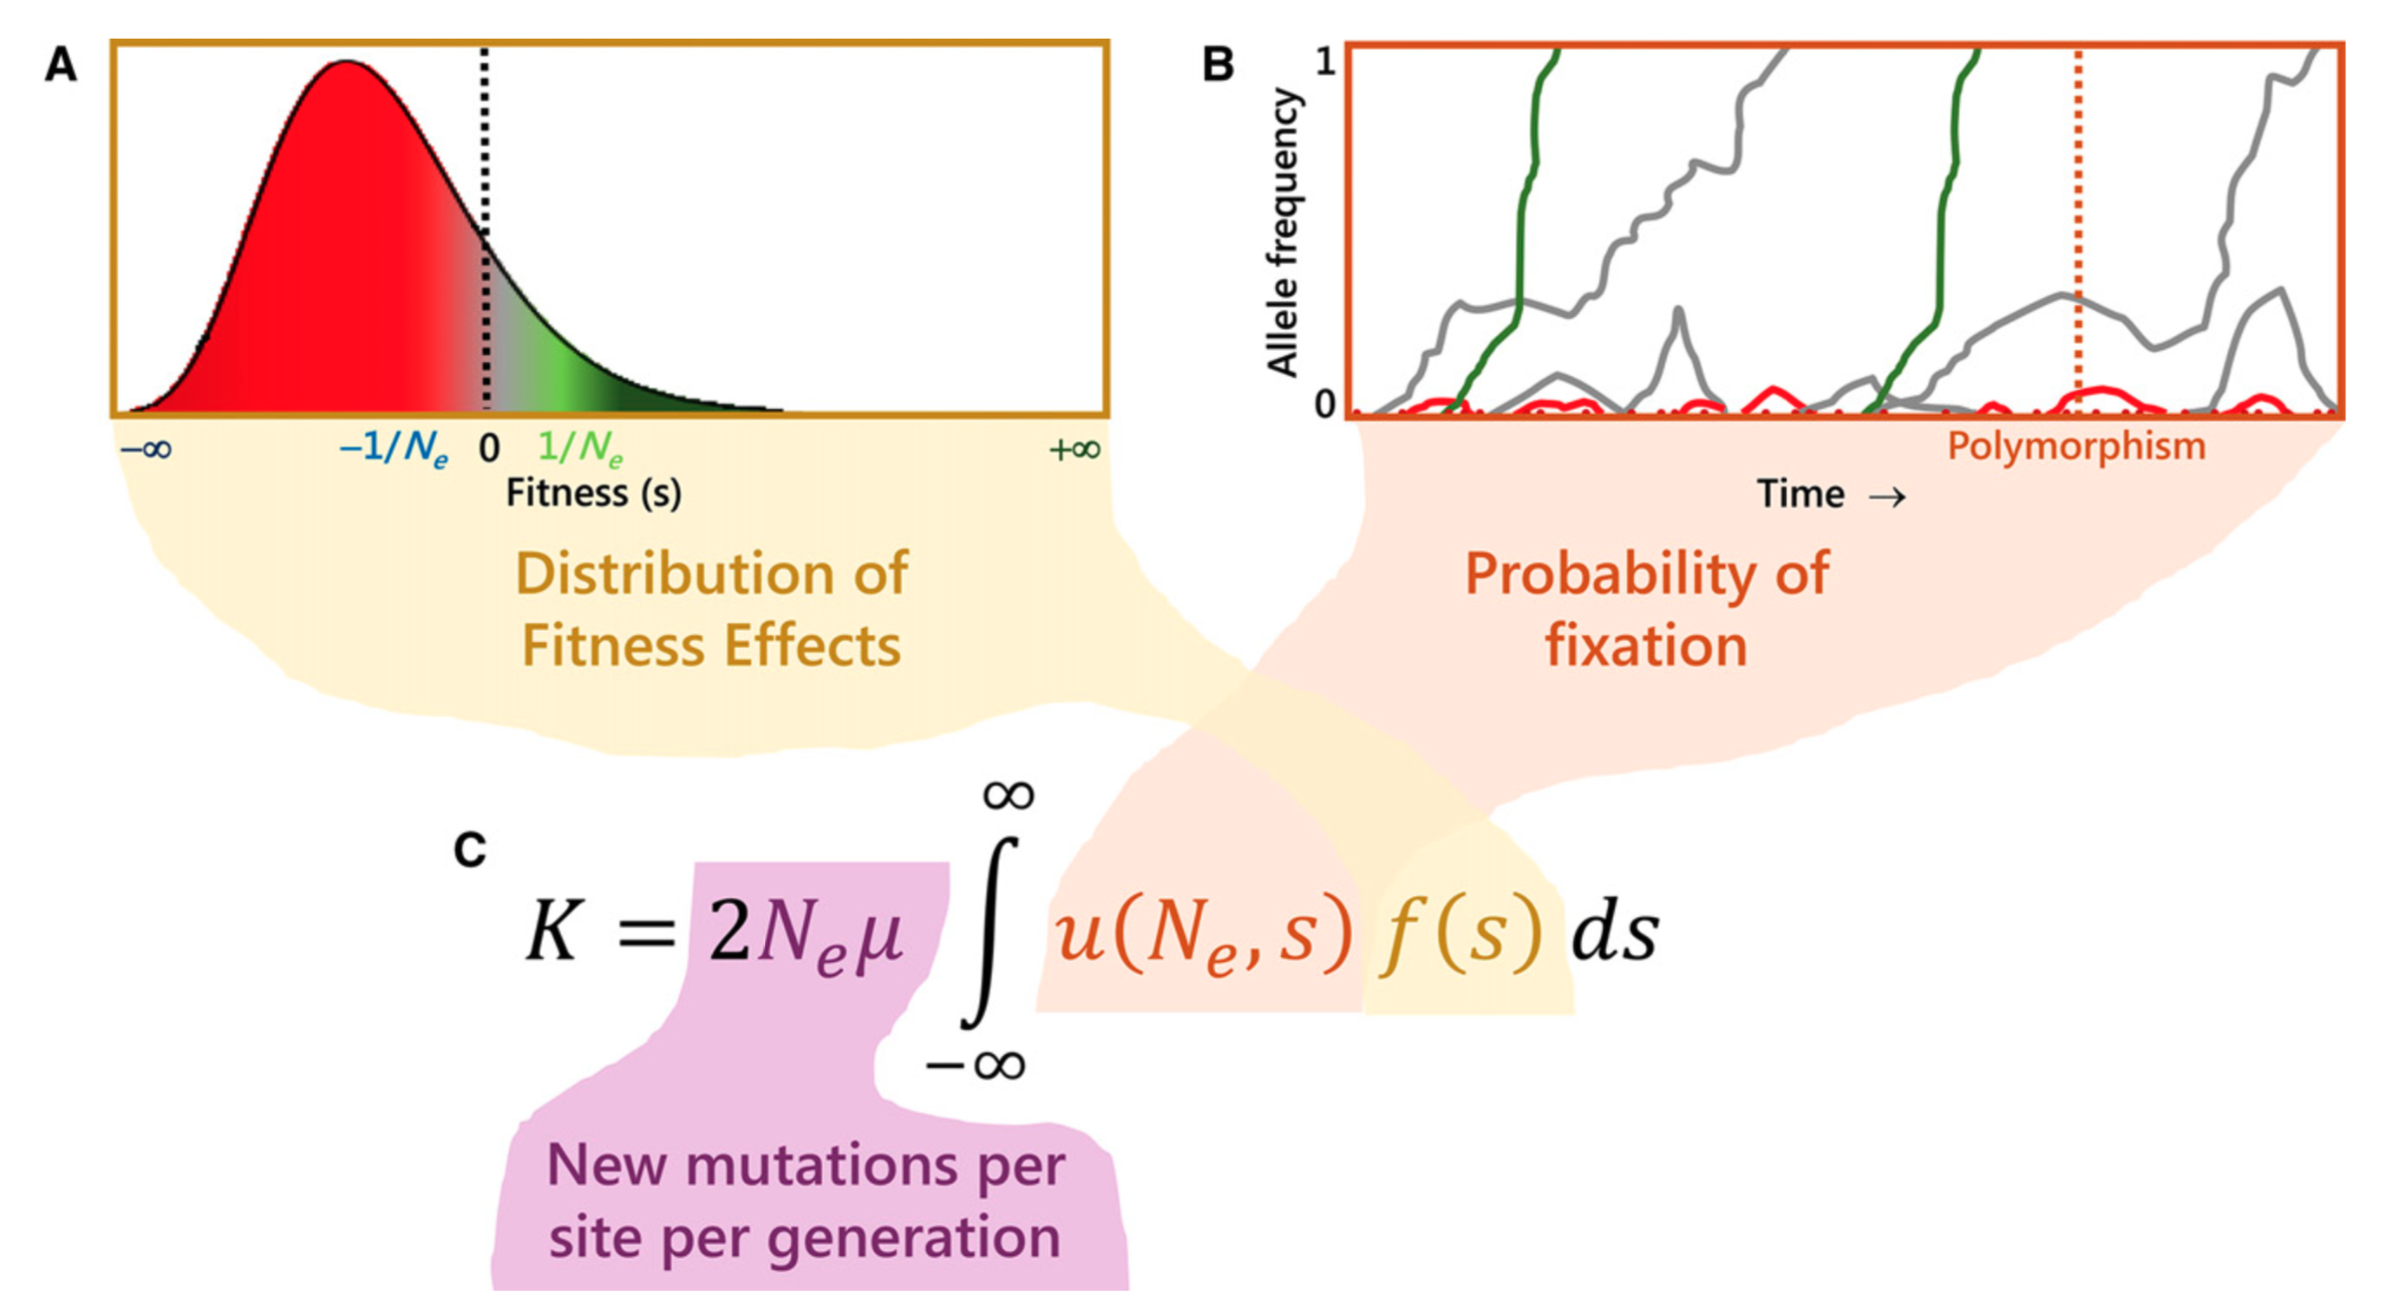
Kimura 1983:
Neutral Theory of Molecular Evolution
Casillas & Barbadilla 2017
The molecular evolutionary rate (K) is a function of the the rate of new mutations and the probability of fixation of mutations

Slide 6

Kimura 1983:
Neutral Theory of Molecular Evolution
Strongly deleterious mutations are rapidly removed from the population and adaptive mutations are rapidly fixed; therefore, most variation within species is the result of neutral mutations
Polymorphisms are transient (on their way to loss or fixation) rather than balanced by selection
The level of polymorphism in a population ($θ$) is a function of the neutral mutation rate ($μ0$) and the effective population size: $θ=2Neμ0$
A steady-state rate at which neutral mutations are fixed in a population ($K$) equals the neutral mutation rate: $K=μ0$ Therefore, the average time between consecutive neutral substitutions is independent of population size or generation time.
Casillas & Barbadilla 2017

Slide 7
Strict clocks and relaxed clocks
Strict molecular clock model: constant substitution rate across all branches
Uncorrelated relaxed clock model: branch substitution rate is drawn independently from a common underlying distribution
Correlated (or autocorrelated) relaxed clock: branch substitution rates depend on the rate of neighboring branches

Slide 8
Langley and Fitch 1974
“Primate slowdown”

Slide 9
Ultrametric trees

Slide 10

Example with tip dating: virus genomes on nextstrain.org
Not every dated tree has to be ultrametric

Slide 11
Substitution rates versus calibration points

Slide 12
Setting calibration points:
Crown or stem?
Strict, normal or log-normal distribution?

Slide 13
Software driven innovation
2019: BEAST (& Beauti) [Java]
2016: TreeTime [phython] used for nextstrain.org
2016: treedater [R] Gamma-Poisson mixture model
2015 (beta): Least-Square-Dating (LSD) [C++]
2015 (beta): PhyTime. [C] Part of PhyML package
2003: r8s [C] [Poisson distribution of substitutions]

Slide 14
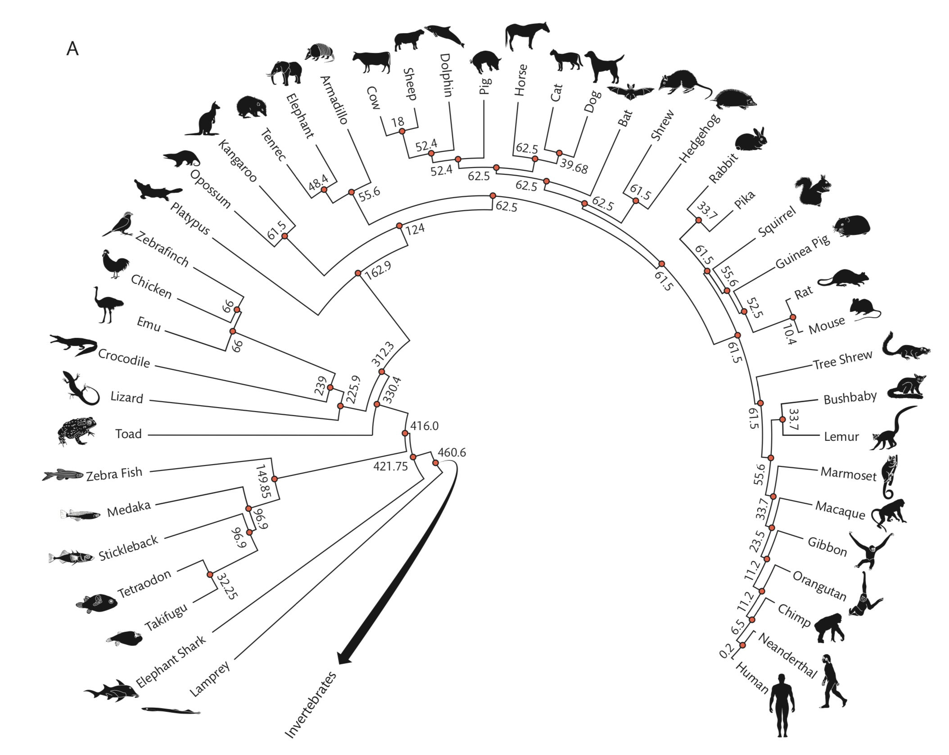
A supertree approach: Timetree.org

Slide 15
References
Zuckerkandl, E., Pauling, L. 1965. Molecules as documents of evolutionary history. Journal of Theoretical Biology 8: 357–366
Dickerson R.E., 1971, “The Structures of Cytochrome c and the Rates of Molecular Evolution”, Journal of Molecular Evolution, 1: 26-45.
Kimura M., 1983, The Neutral Theory of Molecular Evolution, Cambridge: Cambridge University Press.
Langley C. and Fitch W., 1974, “An Examination of the Constancy of the Rate of Molecular Evolution”, Journal of Molecular Evolution, 3: 161-177.
Casillas S, Barbadilla A (2017) Molecular population genetics. Genetics 205: 1003–1035. https://doi.org/10.1534/genetics.116.196493
Hadfield J, Megill C, Bell SM, Huddleston J, Potter B, Callender C, Sagulenko P, Bedford T, Neher RA (2018) NextStrain: Real-time tracking of pathogen evolution. Bioinformatics 34: 4121–4123. https://doi.org/10.1093/bioinformatics/bty407

Slide 16
Lab:
Set up Saturnia molecular dating analysis in Beauti using calibration points and mutation rates
Wahlberg et al. paper for external calibration

